Slide 1


Waterfront Recreation Sites in Philly
CPLN 680 Capstone
Rui Jiang

Slide 2
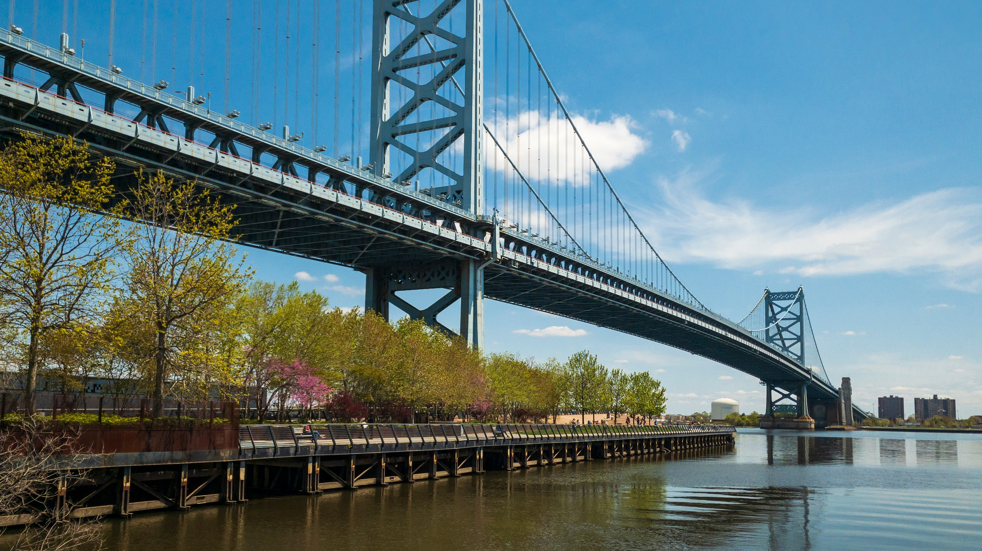



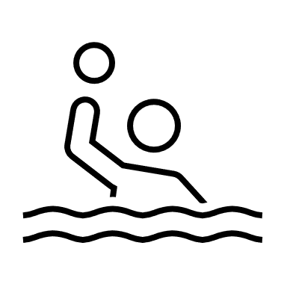
Background Delaware River
serves fifteen million people for drinking, fishing, kayaking, and other recreation
a 27-mile stretch of the river needs improvement
is considered safe for only secondary contact recreation for all time

Slide 3


Motivation
Find out the factors people would take in consideration when choose waterfront recreational sites
Make list of factors that will influence the visiting experience but not already in the previous steps
Make a dashboard that works both in computer and mobile phone for users for convenience in a different usage scenario.

Slide 4
Process & Data
List factors
Finding data
Research on factors
Doing Analysis
Find platform
Organizing Description page and making page of “Build your own map”
Conclusion
report & dashboard

Slide 5


Process & Data
List factors
Finding data
Research on factors
Doing Analysis
Find platform
Organizing Description page and making page of “Build your own map”
Conclusion
report & dashboard

Slide 6
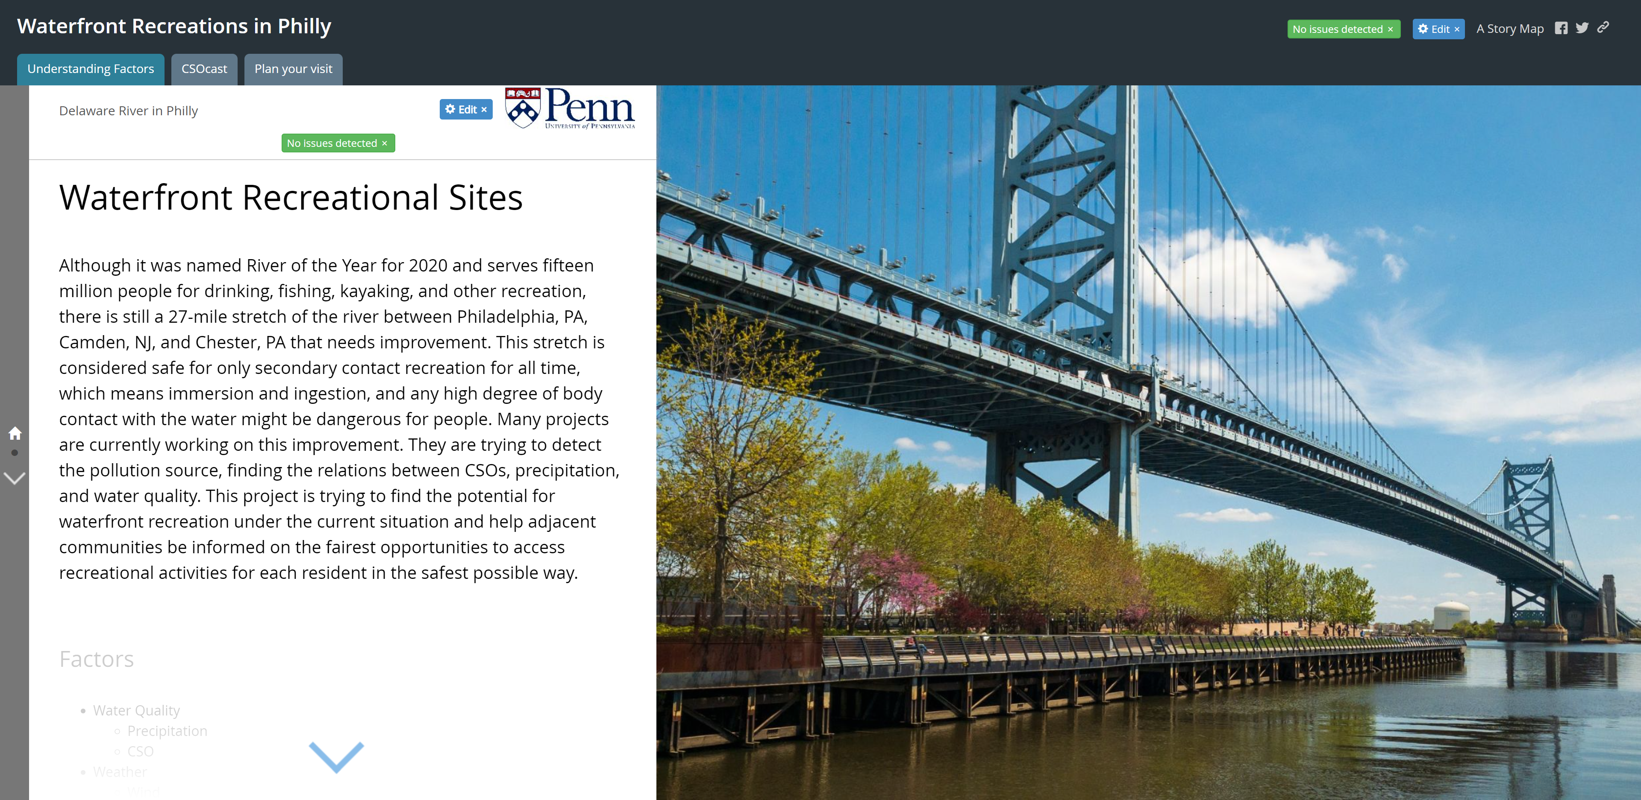

Slide 7
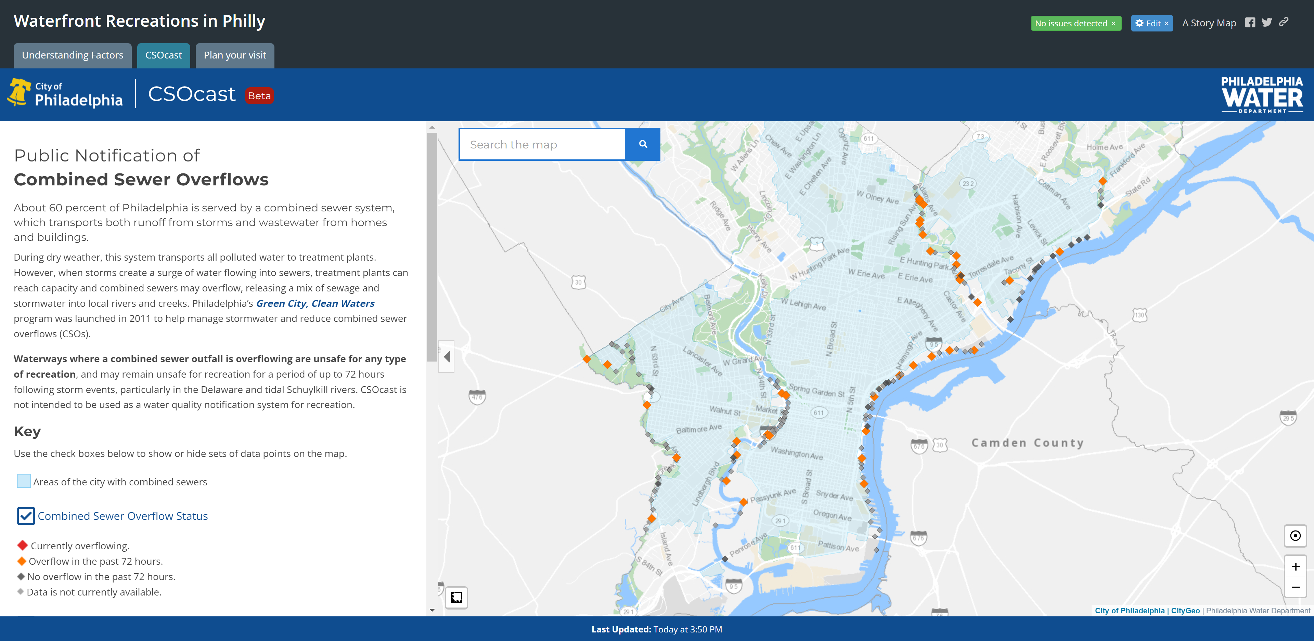

Slide 8
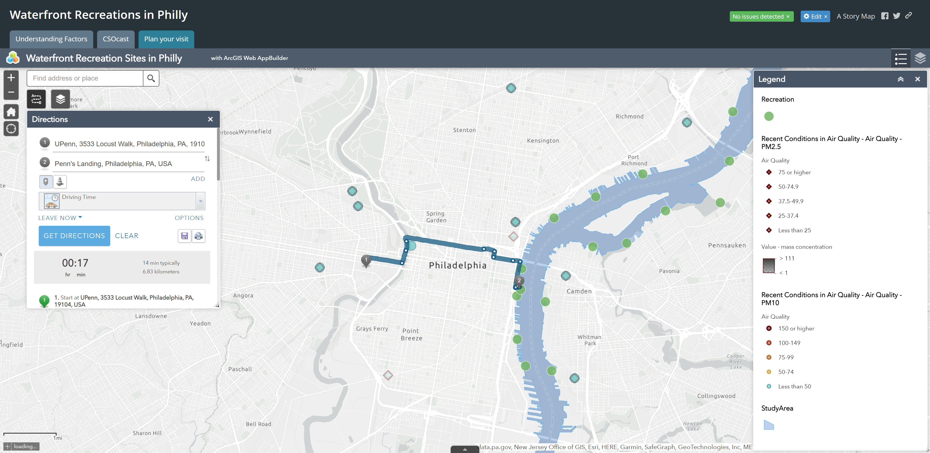

Slide 9
Next Step

Slide 10
Thank you

